Slide 1


Slide 2
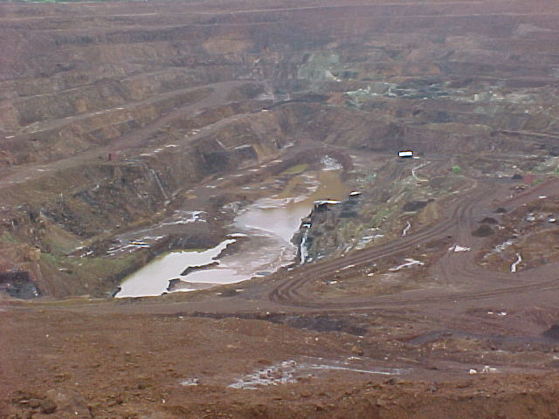
A PANORAMIC VIEW OF A SURFACE MINE

Slide 3
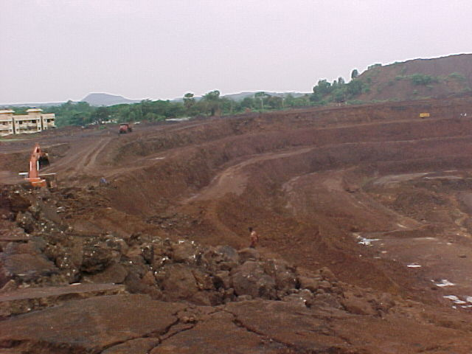
ANOTHER VIEW

Slide 4
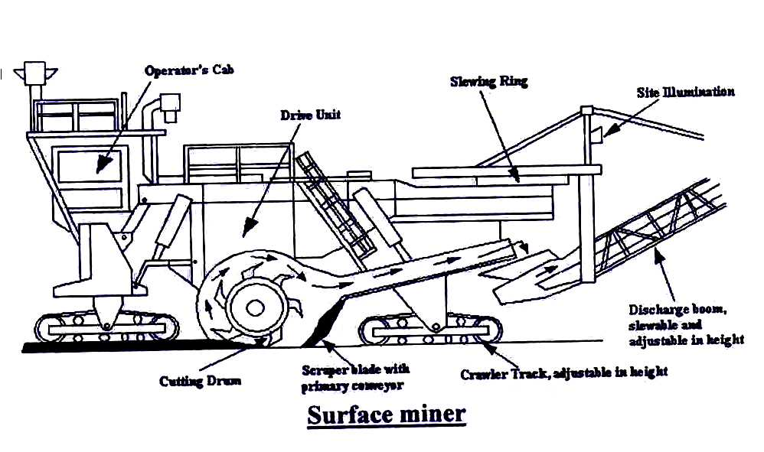
Continuous Surface Miner
Continuous surface miner (CSM) is basically a cutting machine used in surface mines. These machines have been developed during 1970s primarily for extraction of thin seams (not less than 2.5 cm thick) and selective removal of thin dirt bands present in seams.

Slide 5
Methods of work using continuous Surface Miner
In Wirtgen Surface Miner, a type of CSM, a cutting drum, with specified number of replaceable picks mounted on it arranged in form of helix, is fitted below the machine body in between the front and rear crawlers. When the machine works, the hydraulically controlled drum rotates in up-cutting direction. The cutting drum is generally kept in horizontal position during cutting, but can be inclined to some degree by controlling the hydraulic rams to facilitate cutting of inclined seams. During its working, the cutting drum rotates in an up-cutting direction and a layer of predetermined thickness (maximum thickness depends on the machine model) of the deposit is cut and crushed in between the picks. The “Electronic Depth Controller System” fitted in the machine controls the thickness of cut slice/slices. The width of the cut slice is same as the length of the cutting drum. The extraction of slices may be accomplished by following Wide Bench Method or Block Mining Method or Stepped Cut Method depending on the situation.

Slide 6
Wide Bench Method
The wide bench method is generally used when the width of the mineral bench is not very high. In this method, first the uppermost layer of the whole width of the bench is extracted in number of slices followed by the extraction of the next layer and so on till the full height of the mineral bench is extracted.
O/B
14
11
7
3
2
1
Coal
seam
28
20
15
Spoil
42
29
Wide Bench Method

Slide 7
Block Mining Method
The block mining method is adopted when the mineral bench is so wide that the extraction by wide bench method is not suitable. In this method the bench width is suitably divided into number of blocks, and then the block from the edge side of the bench is extracted first for the full height of the bench in number of slices following a sequence similar to that of wide bench method. After completion of one block the next adjacent block is extracted and the process continues till the whole bench is extracted.
O/B
Block III
Block II
Block I
35
31
20
16
5
3
1
Coal seam
40
36
25
21
10
6
Spoil
45
41
30
26
15
11
Block Mining Method

Slide 8
Stepped Cut Method
The stepped cut method is used when excess moisture/water is present in the mineral bench that creates problem in extracting the slices. In this method also the bench is first divided into suitable number of blocks and then the individual slices are so extracted that it forms a number of small steps on the mineral bench. The formation of steps facilitates the drainage from the mineral bench thereby improving the machine efficiency.
O/B
Block III
Block II
Block I
30
26
15
11
5
1
Coal
seam
40
36
25
21
10
6
Spoil
45
41
35
31
20
16
Stepped cut Method

Slide 9
Methods of working based on the Travel Mode
The working methods of Wirtgen Surface Miner, based on the travel mode for extraction of slices of same layer, may be classified into three categories – Empty Travel Back Method, Turn Back Method and Continuous Mining Method.

Slide 10
Empty Travel Back Method
In the empty travel back method, the surface miner starts excavating a slice from one end of the bench and moves upto the other end. After completion of one full cut, the machine travels back empty to the starting end, and sets for a new cut in the adjacent parallel slice, and the process continues. The process is generally adopted under one or more of the following conditions.
Available length of the bench is small (not more than 200m)
Turning time of the machine is more than the empty travel time.
The machine turning is difficult at the cut ends.
Empty Travel Back Method

Slide 11
Turn Back Method
In the turn back method, the surface miner starts cutting a slice from one end of the bench and moves to the other end. After the cut is complete the machine turns back there to start a fresh cut adjacent and parallel to the previous cut. In this way the required number of slices are extracted. The method is most widely accepted and used provided the following conditions exist.
Available length of the bench is more than 200m.
Turning time is less than the empty travel time for the machine.
Required turning space is available at the cut ends.
Turn Back Method

Slide 12
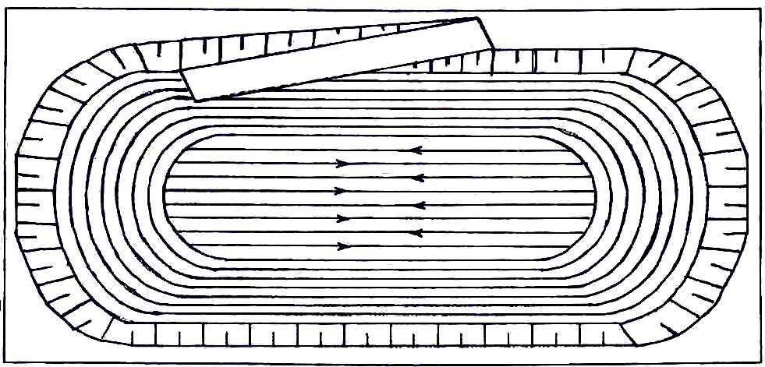
Continuous Mining Method
In continuous mining method, the machine moves with cutting the material and near the pit ends it takes turn with a gentle angle while still cutting the material. Thus there is no discontinuity in cutting operation. This results in a round shape of the cut area particularly at the cut ends. The process continues till the circular/elliptical turnings become so sharp that the machine cannot take turn while continuing the cutting operation. Then the machine follows the turn back method for mining the rest of the material at the central portion.
Continuous mining method

